Slide 1

Introduction To The Team
Applied Statistical Analysis with R Project Presentation
Is Singapore’s HDB resale market in a bubble?
Group: 7
THET Myat Noe
KOH Chin Weng
Sruthi BASANI
Aparna Sudarshan PARAB

Slide 2

Content
Introduction of the Topic
Objective
Data sources
Data preparation
Descriptive statistics
Hypotheses
Inferential statistics (ARIMA)
Linear Regression
Rshiny
Conclusion
Future scope

Slide 3

Introduction Of The Topic
The Property and real estate market is an important facet of the Singapore economy, and the buyer and seller trends can indicate the movement of the economy.
The changes in this market are mostly influenced by purchasing power with the buyers, government regulations and fluctuations in demand.
It can be observed that there is an intense surge in demand with the rise in population of Singapore
The Study of the transformations in this market benefits various stakeholders such as property owners, resellers, buyers and policymakers.
We have conducted a research and analysis on the topic by leveraging both historical data and current market trends, to develop a reliable model that can forecast HDB resale rates in Singapore for the coming years.

Slide 4
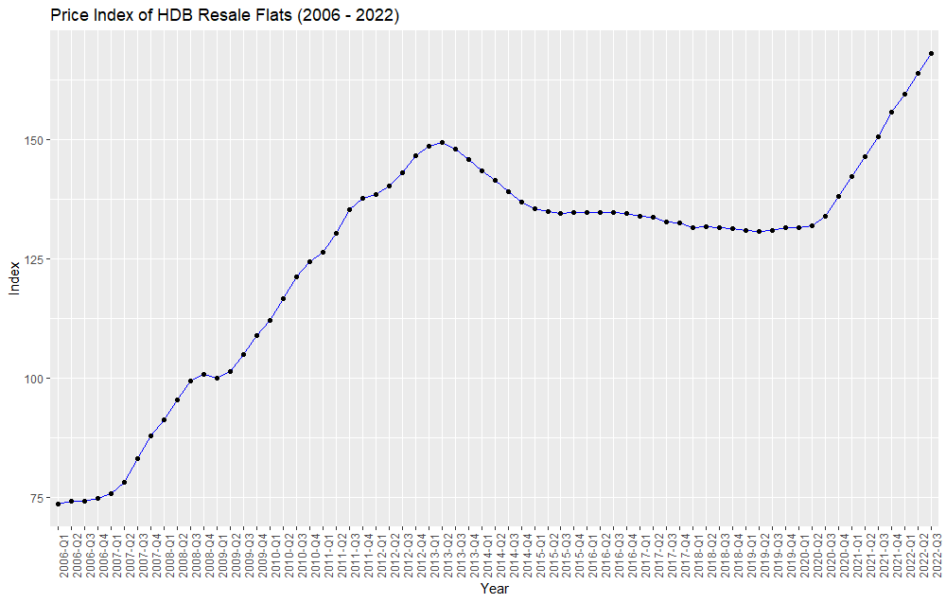
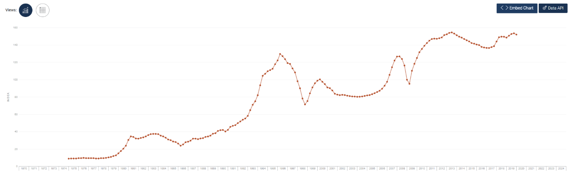

Objective
The objective of this project is to determine if the Singapore property market is in a bubble* & to study the affordability of the properties in the near future.
*A bubble is an economic cycle that is characterized by the rapid escalation of market value, particularly in the price of assets. This fast inflation is followed by a quick decrease in value, or a contraction, that is sometimes referred to as a "crash" or a "bubble burst."(Investopedia)

Slide 5




Data Sources
Variable | Description | Source
Resale Flat Prices | Price of HDB resale transactions by month, town, flat type, block, street name, storey range, floor area (sqm), lease commence date | https://data.gov.sg
Household Net Worth | Net worth of household in Singapore taking into account household assets and liabilities | https://www.singstat.gov.sg
Singapore Overnight Rate Average Interest rate | Singapore Overnight Rate Average Interest rate | https://eservices.mas.gov.sg
HDB Flat Rental Price | Median rental price by town and flat type | https://data.gov.sg

Slide 6





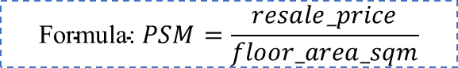
Data Preparation
v
The data is taken from different listed sources and a data set containing 24 data points has been created for this analysis.
The data consists of Property related information such as the flat type, area, locality, resale value, flat model, month of value etc
The data also consists of SORA Interest rates and Household net-worth indicator values such as assets and liabilities. We have used the values for Average SORA rate and Average SORA rate index. These are obtained by averaging out the monthly data for the absolute value and index, separately.
We have also created 2 ratios for affordability using the Household Mortgage/ Household Assets and the Household Liabilities / Household assets
We will be using the PSM(per square meter) value and use the median value as a variable for our analysis instead of the absolute value. The value was derived from resale_price and floor_area_sqm.
$$\text{Formula}\text{:} PSM=\frac{resale_price}{floor_area_sqm}$$

Slide 7
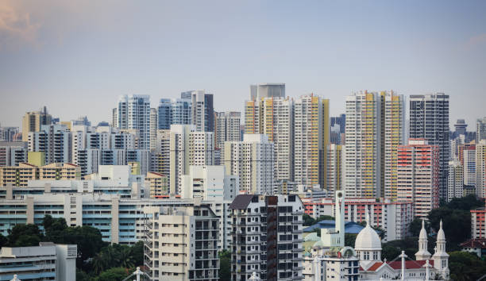
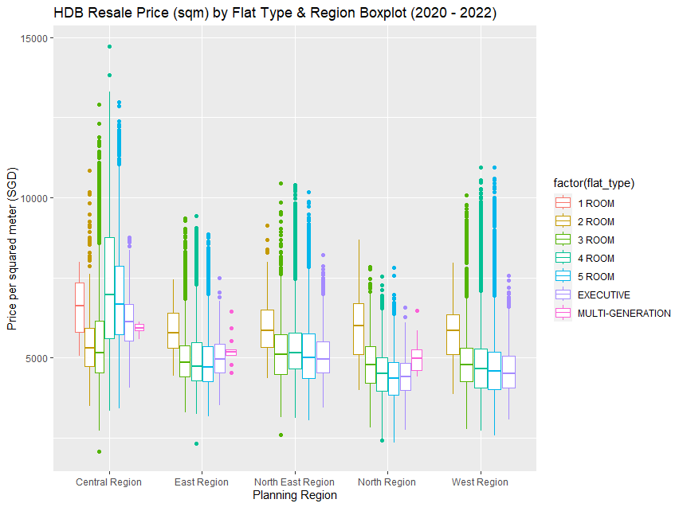
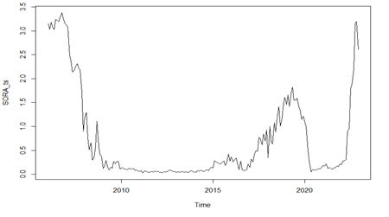
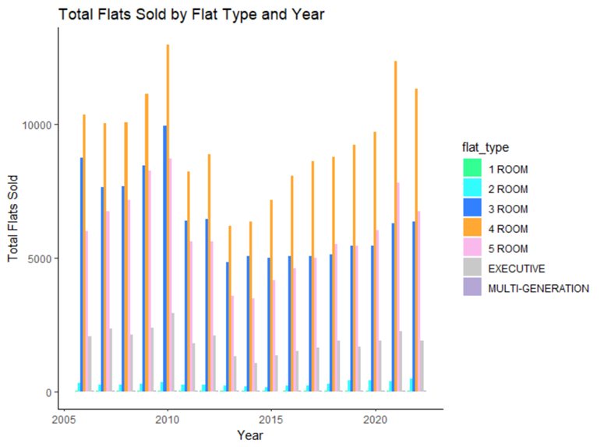
Descriptive statistics
SORA rate vs. Time
PSM vs. Planning region

Slide 8

Hypotheses
1
H0: Prices of public resale housing do not have a linear relationship with the SORA Rates H1: Prices of public resale housing have a linear relationship with the SORA Rates
2
H0: Singaporeans are not at risk of being able to afford public housing H1: Singaporeans are at risk of being able to afford public housing
3
H0: The prices of HDB Resale flats will not be on an upward trajectory in the event of a lack of cooling measures H1: The prices of HDB Resale flats will be on an upward trajectory in the event of a lack of cooling measures

Slide 9
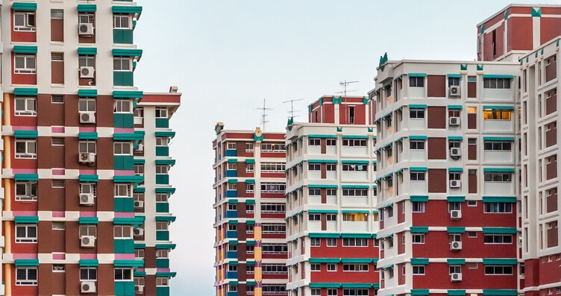
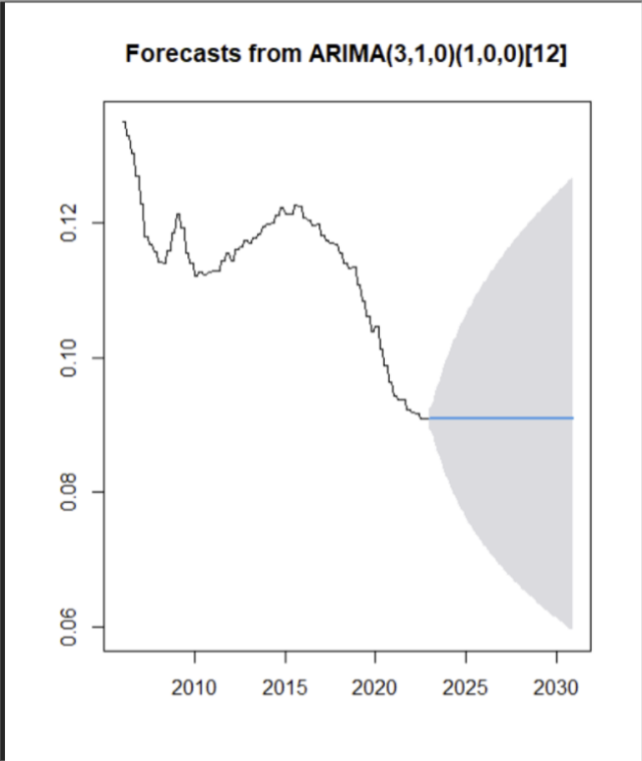
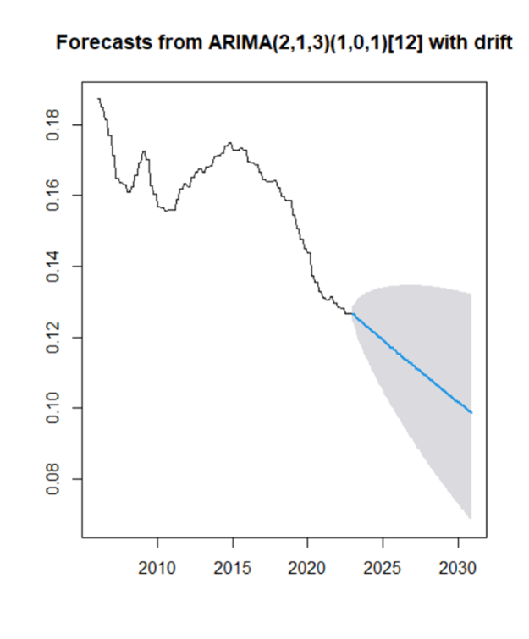

Inferential Statistics- ARIMA (Affordability)
(Lljung box test)
→P value - >0.05
→BIC - 1990
The forecast of the Mortgage to Assets ratio will flatline….
….while the Liabilities to Assets ratio will decline
(Lljung box test)
→P value – 0.05
→BIC - 1886
The Mortgage to Asset ratio is the better model of the 2

Slide 10
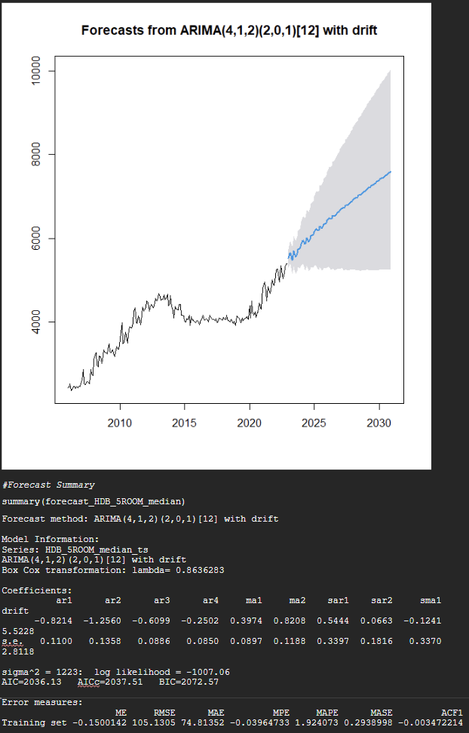
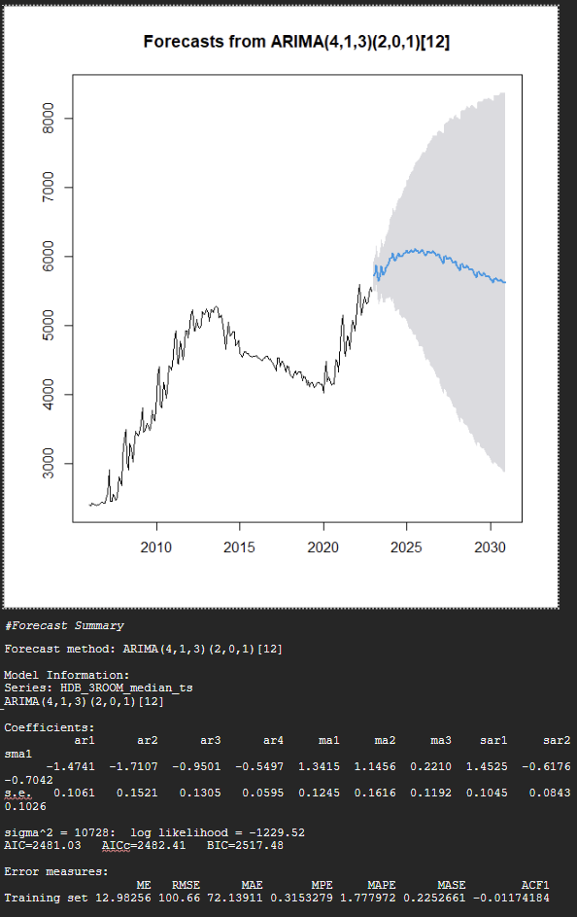
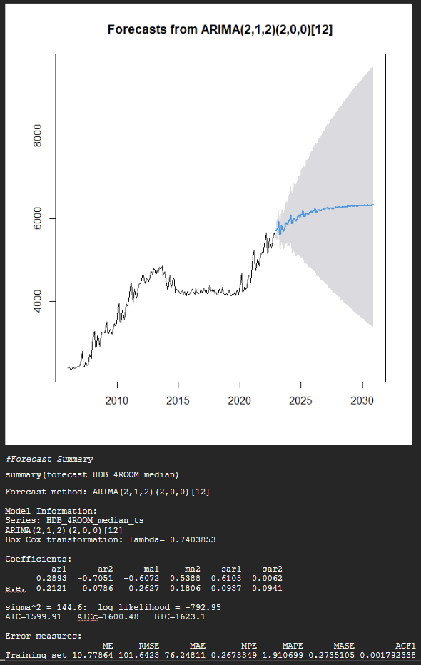


ARIMA (PSM)
For 5 room HDB
For 3 room HDB
For 4 room HDB
The 5 room flats show a trend where the forecast shows that the PSM will rise in the near term while the lower bound remains at a steady level
The forecasted PSM for both the 3 and 4 room resale HDBs are shown to rise in the near term, eventually tapering off and flattening respectively
The Lljung box test gives P value - >0.05 for all 3 models

Slide 11

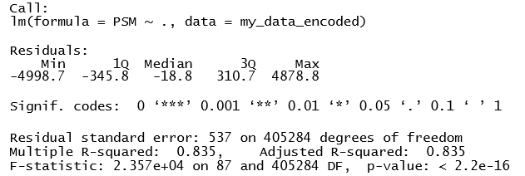
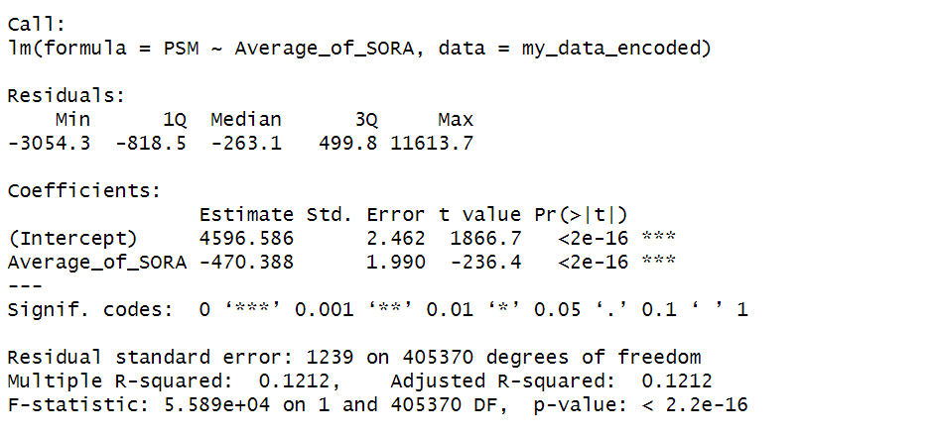
Inferential Statistics- Linear regression (PSM)
A Multiple regression was run using 16 independent variables against the dependent variable, PSM.
Singular Linear regression was conducted with Independent variables such as lease_commence_date, median_rent, Average_of_SORA and others
{the coefficients have been excluded from the output here due to length}

Slide 12


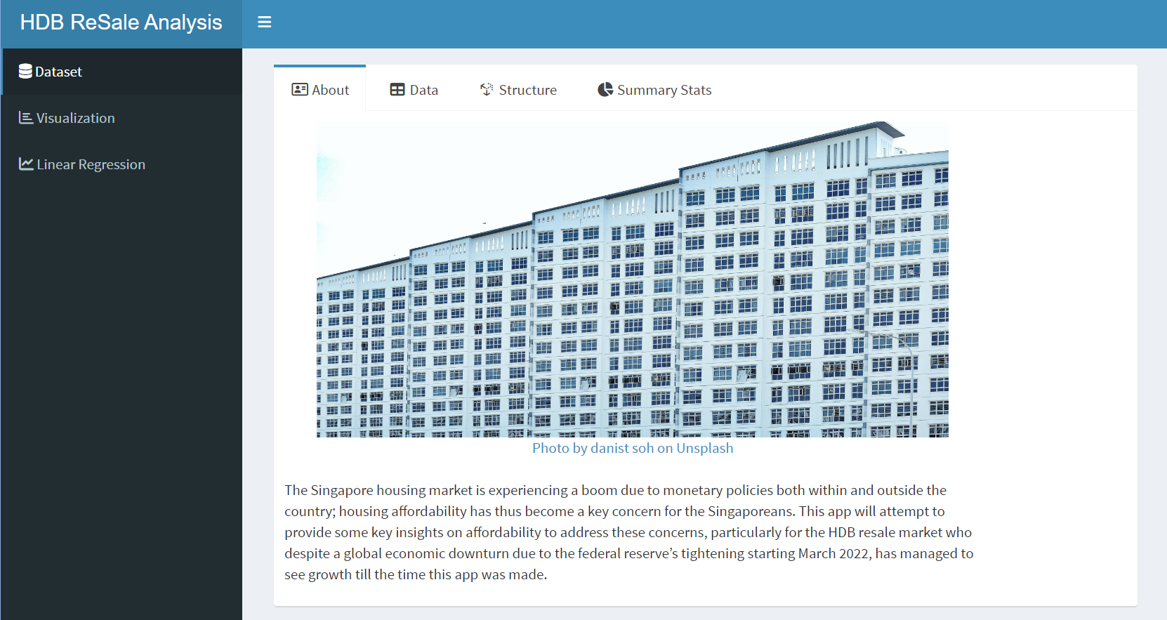
Rshiny
The Rshiny application enables the clear demonstration of not only Visual aspects of the analysis but also allows the user to perform a linear regression using the variables from the dataset

Slide 13


Conclusion & Recommendations
The Prices (PSM) of the HDBs will increase or decrease based on flat type.
The forecast shows that HDB resale flats will remain affordable.
It is also observed that the SORA rates have been ineffective (given low R-squared value 0.121) as a cooling down measure. We recommend intervention from the government to lower PSM levels should the prices get out of hand.

Slide 14
Future scope
This study excludes the other residential property types and only focuses on HDB resale price. All the property types and type of sales should be included in the extended research.
The location of the property should be the basis for further research as it shows higher corelation to the PSM
Notes:
As the HDB data was not at par with the rest of the data, we decided to exclude it from the study.

Slide 15

Thank you

